Slide 1

Detection of Poisonous Mushrooms using Machine Learning
V.Saketh – 18071A12B9
V.Bharath Sri Vardhan – 18071A12B9
K.Sai Sowmith – 18071A1285

Slide 2
INTRODUCTION
A mushroom appears to grow like a plant, but it isn't a plant. Genetically, mushroom bodies are closer to those of animals, but a mushroom isn't an animal, either. It's a fungus.
Mushroom poisoning can cause a wide range of symptoms including gastroenteritis, hallucinations, and anxiety.
Poisonous mushrooms, such as Amanita sp. and others, can cause acute fatal liver necrosis.
Mushrooms with white gills are often poisonous. So are those with a ring around the stem and those with a volva.

Slide 3
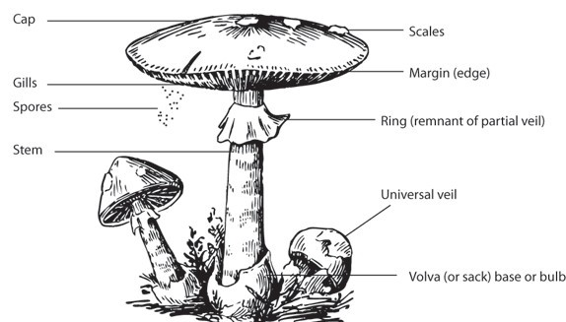

PROBLEM STATEMENT
Classification of Mushrooms into edible mushrooms or poisonous mushrooms using their features.
Features such as cap structure, gill structure, stalk structure, population and habitat are considered for classification.

Slide 4
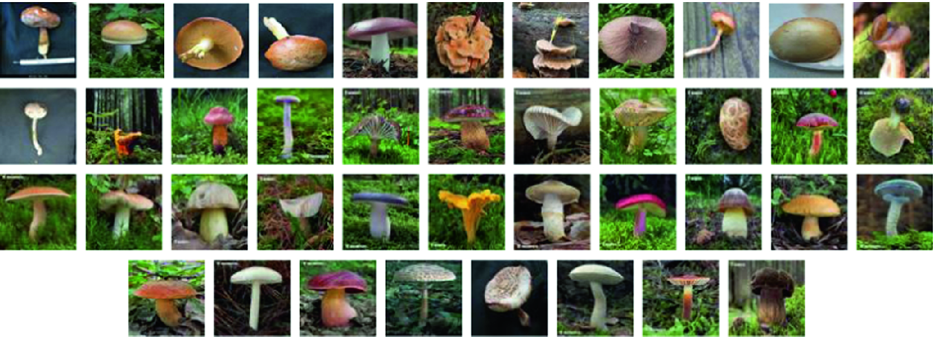
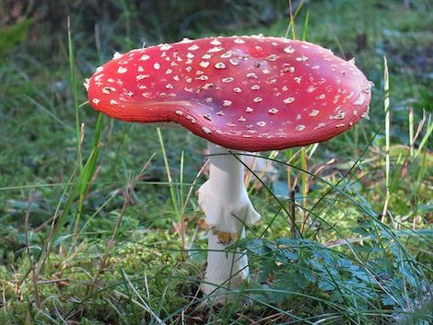
SOLUTION
Training the data using Machine Learning Algorithm
Trained Model
Poisonous or Edible

Slide 5
Algorithms used
Support Vector Machines
Random Forest Classifier
K – Nearest Neighbors
Gaussian Naive Bayes
Feed forward neural networks

Slide 6
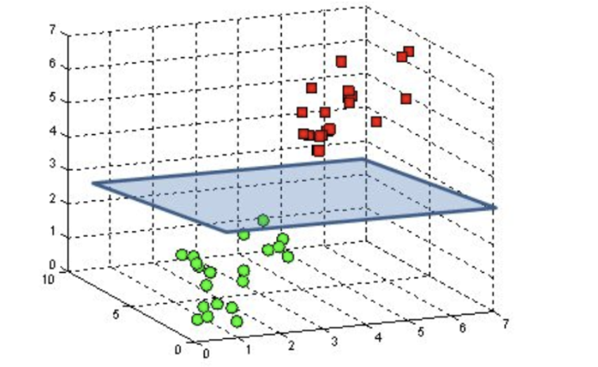
Support Vector Machines
A support vector machine is a machine learning model that uses classification algorithms for two-group classification problems.
The Objective of SVM is to find a hyperplane in an N – Dimensional space that classifies the data points.

Slide 7
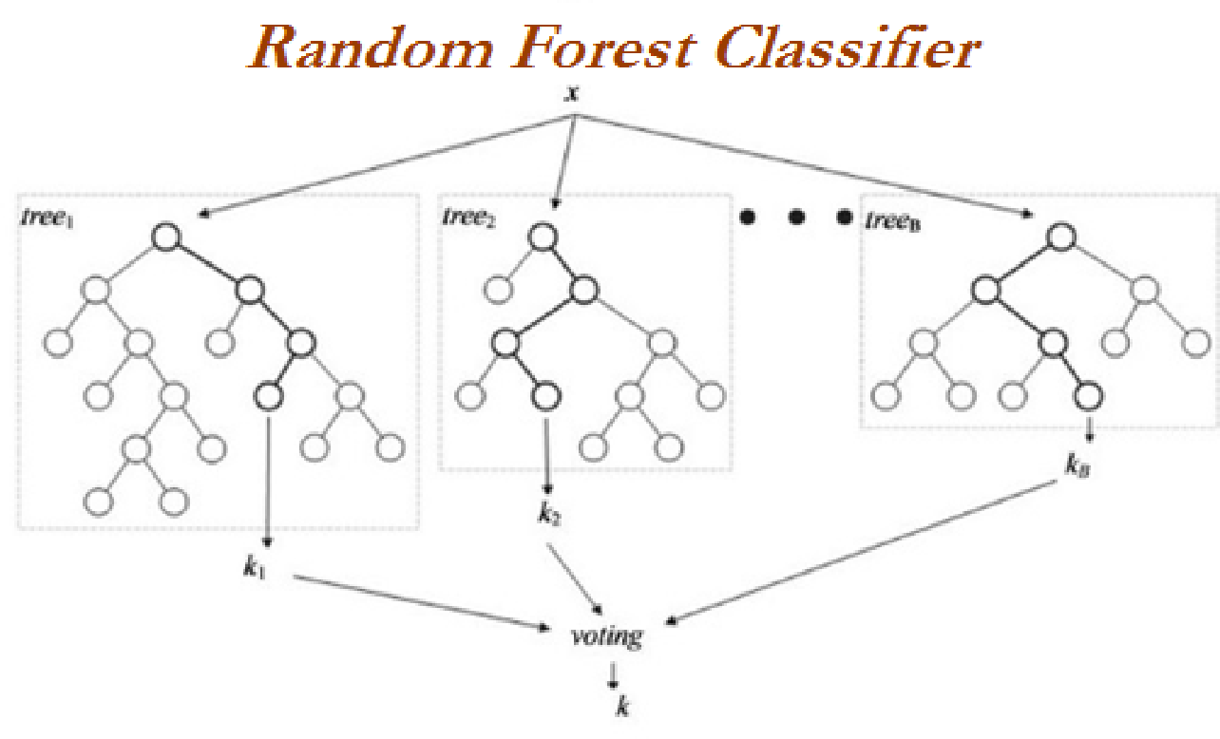
Random Forest Classifier
Random forest builds multiple decision trees and merges them together to get a more accurate and stable prediction.
It has an effective method for estimating missing data and maintains accuracy when a large proportion of the data are missing.
A decision tree is built on an entire dataset, using all the features/variables of interest, whereas a random forest randomly selects observations/rows and specific features/variables to build multiple decision trees from and then averages the results.

Slide 8
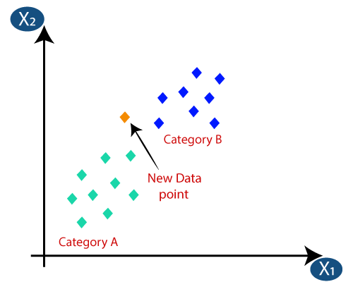
K – Nearest Neighbors
The k-nearest neighbors (KNN) algorithm is a simple, supervised machine learning algorithm that can be used to solve both classification and regression problems.
Suppose there are two categories, i.e., Category A and Category B, and we have a new data point x1, so this data point will lie in which of these categories. To solve this type of problem, we need a K-NN algorithm. With the help of K-NN, we can easily identify the category or class of a particular dataset

Slide 9
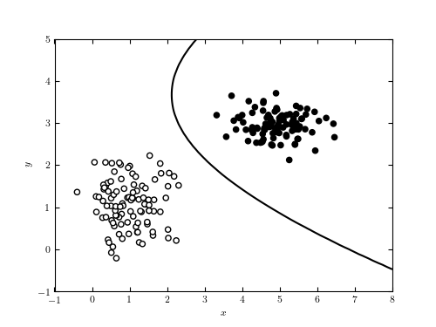
Gaussian Naive Bayes
Gaussian Naive Bayes is a variant of Naive Bayes that follows Gaussian normal distribution and supports continuous data.
Naive Bayes Classifiers are based on the Bayes Theorem.
Naive Bayes Classifiers have simple design and implementation, and they can apply to many real-life situations.

Slide 10
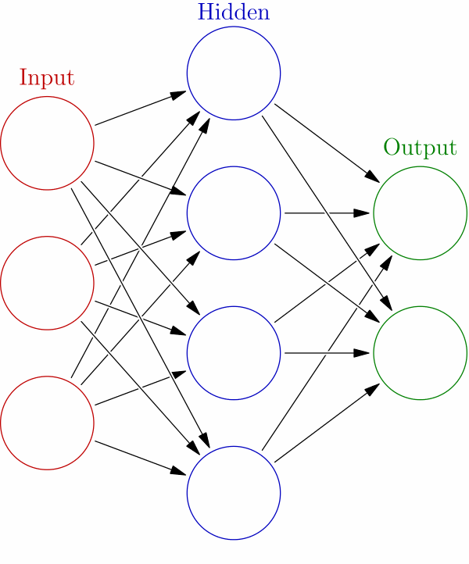
Feed forward neural networks
A feedforward neural network is an artificial neural network wherein connections between the nodes do not form a cycle.
The feedforward neural network was the first and simplest type of artificial neural network devised.
Data enters at the inputs and passes through the network, layer by layer, until it arrives at the outputs.

Slide 11
Accuracy
Algorithm | Precision | Recall | F1 score | Support | Accuracy
SVM | 91.5 | 90.5 | 91 | 1219 | 90.85%
KNN | 93.5 | 93 | 93 | 1219 | 93.07%
Random Forest | 93.5 | 92.5 | 92.5 | 1219 | 92.9%
Gaussian Naive Bayes | 90.5 | 89.5 | 90 | 1219 | 89.66%
Feed Forward Neural Networks | 93.5 | 93.0 | 92.5 | 1219 | 93.0%

Slide 12
Conclusion
We can classify whether the given mushroom is edible or poisonous using the machine learning model that is trained using the data set.
We can classify around 90% of the mushrooms correctly.

Slide 13
Future Scope
After using necessary algorithms for classifying the mushrooms as poisonous or edible we wanted to use CNN algorithm to classify as poisonous or edible based on the features of the mushroom like odor, spore print color, gill size, gill color etc. This classification based on neurons and weights gives us more accuracy and we can directly send images as input into the model which will be the next level of our implementation. In future work we will attempt to remove some actual measurement from mushroom pictures like cup breadths, stem tall, shading and surface. Additionally, we will attempt to grow the dataset and utilize more pictures to improve order measure.

Slide 14
Thank You

